Slide 1

Targeting customers for specific campaigns
Karen Trejo

Slide 2
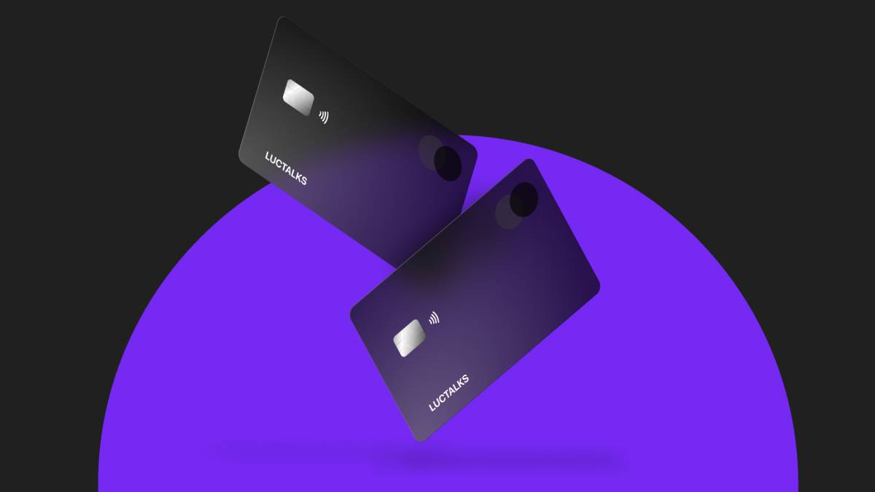
Index
xx
xx

Slide 3
Communication protocols

Slide 4
Selected topic
At my current job in the banking and tech industry,, I am struggling with some clients requesting over and over for products we don't have and we won't have due to risk-benefit analysis. Anyhow, some clients understand this well enough and some others don't. Big part of the deal would be not being able to communicate the right way with everyone.
Therefore,I decided to practice on Cluster Analysis to be able to analyse personas without really knowing them and building them up. Then, I would like to practice on Random Forests as sometimes I believe in my current job poeple use Multivariate Regression and Logistic Regression as the solely models, when I have seen here we have many more that could also work well enough.

Slide 5
Dataset
The dataset I chose has information on the consumption habits from different credit card users to understand what type of campaigns could be directed to whom.
Number of observations: 8950
Label variable: No
Number of variables: 17
Type of data: All numerical data.
The variables in the dataset are: BALANCE, PURCHASES, PRC_FULL_PAYMENT, INSTALLMENTS_PURCHASES, etc

Slide 6
Answers that want to answer:
Can we differentiate between different tribes of people according to the use they have on their credit card?
Can there be a specific type of communication or way to communicate that would improve the client actually listening the message?
Can we predict with this information what tribe do future clients belong to?

Slide 7




Credit Card Personas

